Slide 1


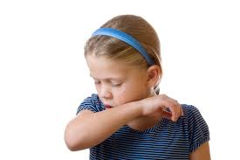
Respondent Conditioning

Slide 2
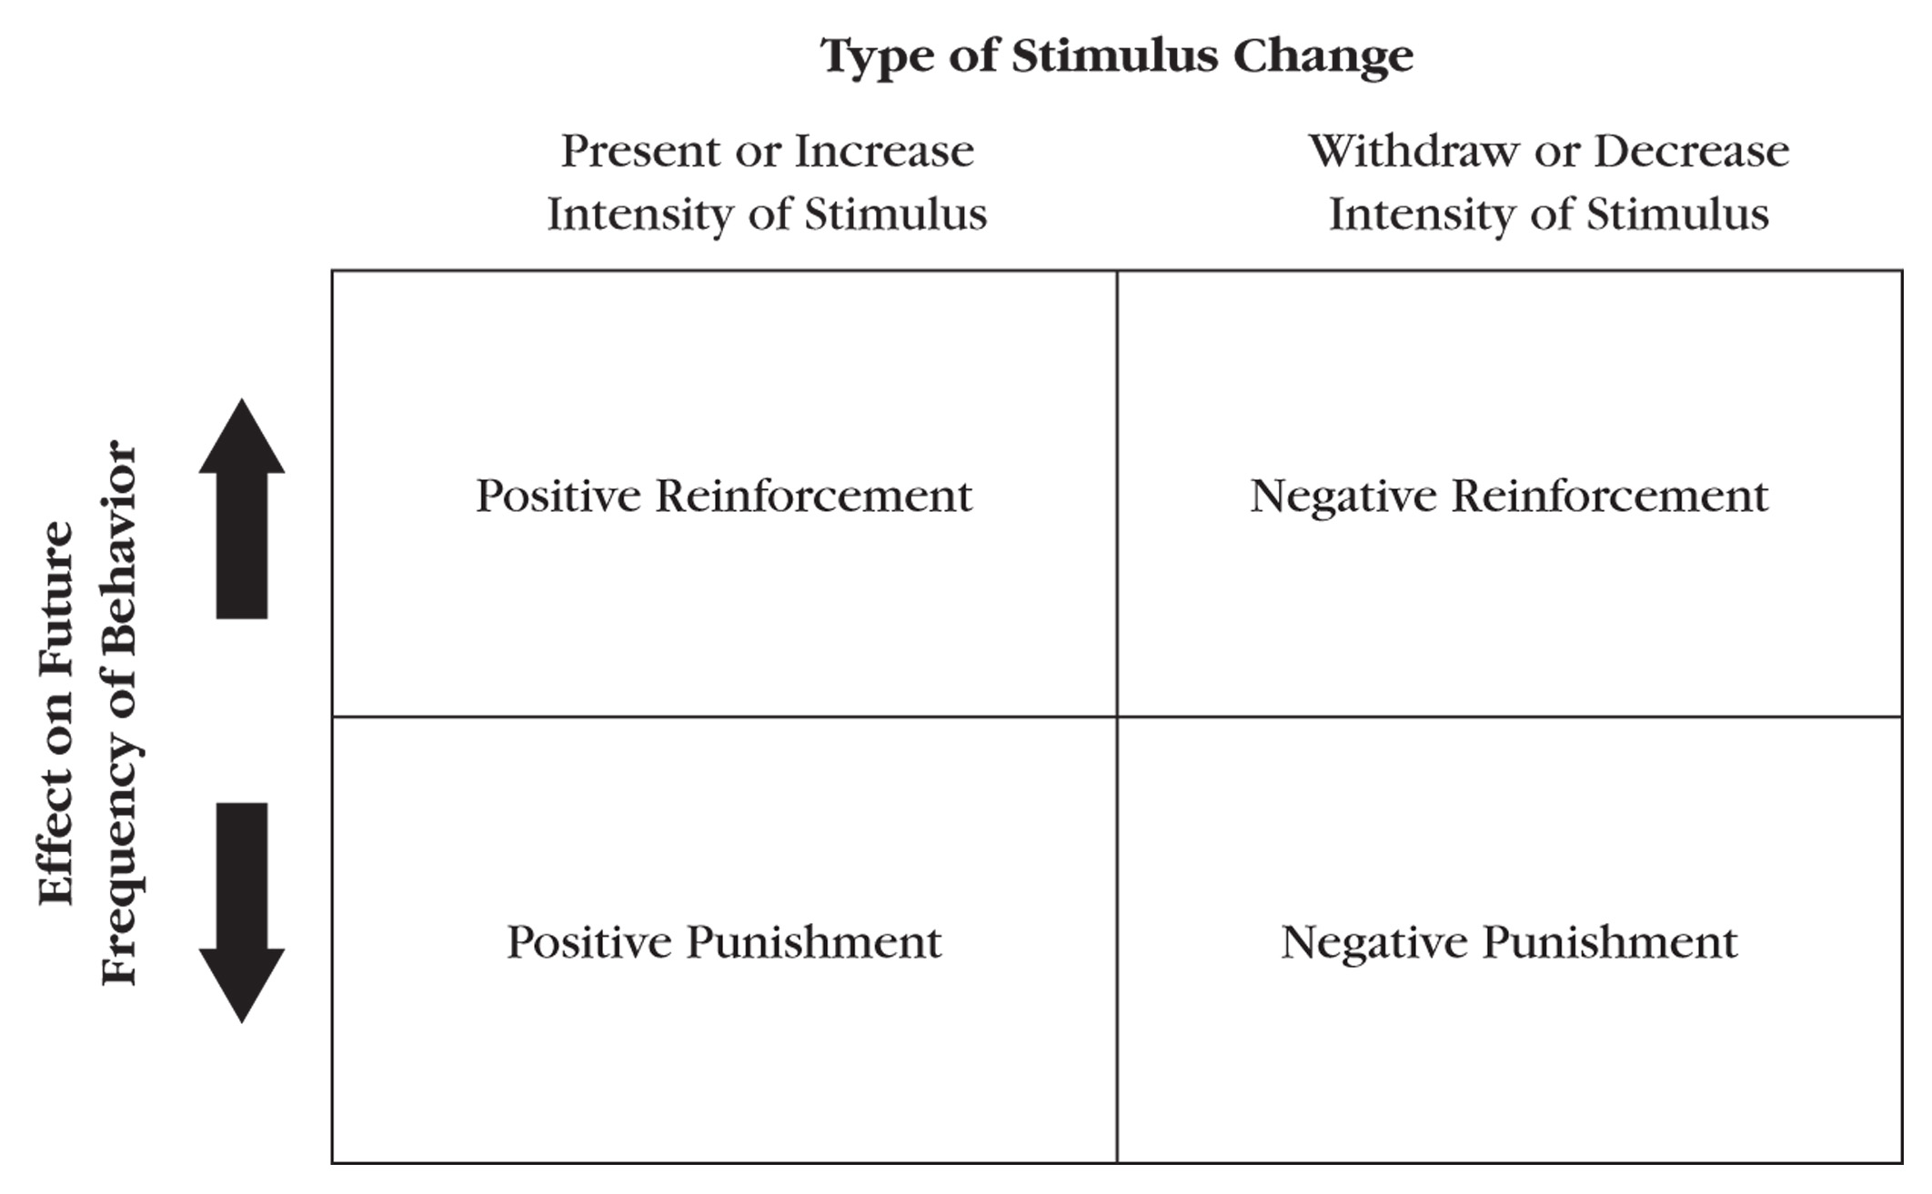
Don’t Forget Operant Conditioning First
Operant behaviors are controlled by their consequences:
Positive and Negative Reinforcement or Punishment
Learned behaviors because of the consequences that follow them

Slide 3
Operant Behavior
Any behavior whose future frequency is determined primarily by its history of consequences
Selected
Shaped
Maintained by consequences
Defined functionally, by their effects

Slide 4
Selection by Consequences
All forms of life, from single cells to complex cultures, evolve as a result of selection with respect to function
Pennypacker, 1994, pp. 12 -13
Ontogeny
Operates during the lifetime of the individual
Phylogeny
Natural selection in the evolution of a species

Slide 5
Operant Conditioning
Process and selective effects of consequences on behavior
“Functional consequence”
Stimulus change that follows a given behavior in a relatively immediate temporal sequence and alters the frequency of that type of behavior in the future

Slide 6
Discriminated Operant
Occurs more frequently under some antecedent conditions than it does under others
Stimulus Control
Differential rates of operant responding observed in the presence or absence of antecedent stimuli
Due to pairings (antecedent/consequence) in the past, antecedents acquire the ability to control operant behavior

Slide 7
Motivating Operations
Alters the current value of stimulus changes as reinforcement or punishment
Satiation
Deprivation

Slide 8
Respondent Behaviors
Respondent behaviors are “elicited” by antecedent stimuli.
Reflexes (unlearned)
Examples:
Your response to allergens → sneeze
Your response to bright light →pupils contract
Your response to a tingle in your throat → cough

Slide 9

So What is Respondent Conditioning?
Learning occurs due to stimulus-stimulus pairings
New or neutral stimuli (NS) can acquire the ability to ELICIT respondents (Cooper et. al., 2020)
Classical conditioning is the first prime example: PAVLOV

Slide 10
Classical Conditioning
Food in mouth (Unconditioned Stimulus US)= Salivation in mouth when given food (Unconditioned Response UR)
Neutral stimulus (NS)= Metronome played right before food was given to dog

Slide 11
Classical Conditioning
Food was immediately followed by the sound of the metronome for a few trials. This resulted in:
Dogs salivating every time the metronome was played
Metronome= conditioned stimulus (CS)
Salivating in the presence of the metronome= CR (conditioned response)

Slide 12
Some Important Terms
Unconditioned stimulus (US)
Unconditioned response (UR)
Conditioned stimulus (CS)
Conditioned response (CR)
Neutral Stimulus (NS)

Slide 13
Unconditioned Stimulus
US
(food pellet)
An US elicits behavior without any learning history with regard to that stimulus.

Slide 14
Unconditioned Response
US
(food pellet)
UR
(salivation)
An UR is a reflex response elicited by an US. The food pellet elicits salivation.

Slide 15
Respondent Conditioning
US
(food pellet)
UR
(salivation)
pairing
NS
(click of pellet dispenser)
Following repeated pairings of the US and a neutral stimulus...

Slide 16
Respondent Conditioning
CS
(click of pellet dispenser)
CR
(salivation)
…the neutral stimulus, when presented alone, elicits the CR. The neutral stimulus is now a CS (no longer neutral) because of the conditioning history.

Slide 17
In respondent conditioning, the conditioned and unconditioned stimuli are presented without regard to the organism’s behavior. (no contingency)
Notes:
Rat did not have to do anything in previous example

Slide 18
Respondent vs. Operant
Respondent conditioning
Stimuli precede response
No response required
Involuntary
Operant conditioning
Consequences follow responses
Response required
Voluntary

Slide 19

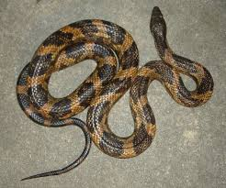
Phobias and Fears
Responses that can become CR in presence of neutral stimuli (i.e., spiders, frogs, heights, etc.) after multiple stimulus-stimulus pairings
Auditory
Visual
Tactile
Gustatory
Vestibular
Social
Thermal
Olfactory
Notes:
https://www.youtube.com/watch?v=Bnos94Rtujw

Slide 20
Some Current Dimensions of applied Behavior Analysis

Slide 21
Development of ABA
1960’s
Researchers began to apply principles of behavior in an effort to improve socially important behavior
Techniques for measuring behavior & controlling & manipulating variables were sometimes unavailable, or inappropriate
Notes:
No ready outlet for publishing studies
Difficult to communicate findings

Slide 22
Development of ABA
Application of behavior principles to education is a major area of impact
Provided the foundation for:
Behavioral approaches to curriculum design
Instructional methods
Classroom management
Generalization and maintenance of learning

Slide 23
Development of ABA
1968 – Formal beginning of contemporary applied behavior analysis
Journal of Applied Behavior Analysis (JABA) began publication
“Some Current Dimensions of Applied Behavior Analysis” (Baer, Wolf, & Risley)
Notes:
1960’s & 1970’s
Many new university programs were developed in applied behavior analysis
Teaching & research conducted in these programs made major contributions to the rapid growth of the field

Slide 24
Development of ABA
JABA
First journal in U.S. to deal with applied problems
Published applications of information found in EAB
Flagship journal of ABA

Slide 25
Development of ABA
“Some Current Dimensions of Applied Behavior Analysis” (Baer, Wolf, & Risley)
Founding fathers of the new discipline (ABA)
Defined the criteria for judging adequacy of research & practice in ABA & outlined the scope of work for those in the science
Most widely cited publication in ABA
Remains standard description of the discipline

Slide 26
7 Dimensions of ABA
Applied
Investigates socially significant behaviors with immediate importance to the participant(s)
Examples include behaviors such as:
Social
Language
Academic
Daily living
Self-care
Vocational
Recreation and/or leisure
Notes:
Recommended seven defining dimensions for research or behavior change programs

Slide 27
7 Dimensions of ABA
Behavioral
Precise measurement of the actual behavior in need of improvement & documents that it was the participant’s behavior that changed
The behavior in need of improvement and it is a study of behavior (not about behavior)
The behavior must be measurable
Important to note whose behavior has changed

Slide 28
7 Dimensions of aba
Technological
Written description of all procedures in the study is sufficiently complete and detailed to enable others to replicate it
All operative procedures are identified and described in detail & clarity
Replicable technology

Slide 29
7 dimensions of aba
Analytic
Demonstrates experimental control over the occurrence and non-occurrence of the behavior (a functional relation is demonstrated)
Functional & replicable relationships

Slide 30
7 dimensions of aba
Conceptually systematic
Behavior change interventions are derived from basic principles of behavior
Better enable research consumer to derive other similar procedures from the same principle(s)
Assist in integrating discipline into a system instead of a “collection of tricks”

Slide 31
7 dimensions of aba
Effective
Improves behavior sufficiently to produce practical results for the participant(s)
Improvements in behavior must reach clinical or social significance
Extent to which changes in the target behavior(s) result in noticeable changes

Slide 32
7 dimensions of aba
Generality
Produces behavior changes that last over time…
Appear in other environments (other than the one in which intervention was implemented)…
Or spread to other behaviors (those not directly treated by the intervention)

Slide 33
Additional Characteristics of ABA
Accountable
Created by the focus on
Accessible environmental variables that reliably influence behavior
Reliance on direct & frequent measurement to detect changes in behavior
Detect successes and failures
Allow changes to be made
Notes:
Offers society an approach toward solving problems

Slide 34
Additional Characteristics of ABA
Public
Visible, explicit, & straightforward
Of value across a very broad spectrum of fields

Slide 35
Additional Characteristics of ABA
Doable
Not prohibitively complicated or arduous
Variety of individuals are able to implement principles and interventions
Does involved more that learning to do some procedures

Slide 36
Additional Characteristics of ABA
Empowering
Provides practitioners with real tools that work
Raises confidence
Increases confidence for future challenges

Slide 37
Additional Characteristics of ABA
Optimistic
Possibilities for each individual (Strain et al., 1992)
Detect small improvements
Positive outcomes yield a more optimistic attitude about future successes
Peer-reviewed literature provides many examples of success

Slide 38
Definition of ABA
A scientific approach to improving socially significant behavior…
In which procedures derived from the principles of behavior are systematically applied to improve socially significant behavior…
And to demonstrate experimentally that the procedures employed were responsible for the improvement in behavior

Slide 39
Six Key Components of ABA
Guided by attitudes of methods of scientific inquiry
All behavior change procedures are described & implemented in a systematic, technological manner
Only procedures conceptually derived from basic principles of behavior are circumscribed by the field

Slide 40
Six Key Components of ABA
Focus is socially significant behavior
Seeks to make meaningful improvement in important behavior
Seeks to produce an analysis of the factors responsible for improvement

